Slide 1

Local Renewable Energy Transition Strategies
NorCal AEE Chapter Webinar
Gerald Braun, IRESN
January 21, 2021

Slide 2
Outline
Global, National and State
Global Renewable Transition
Renewable Power in the US and California
Local Renewable Energy
Deployment
Costs
Benefits
Local Renewable Energy Transitions
Targets
Strategies
Implementation

Slide 3
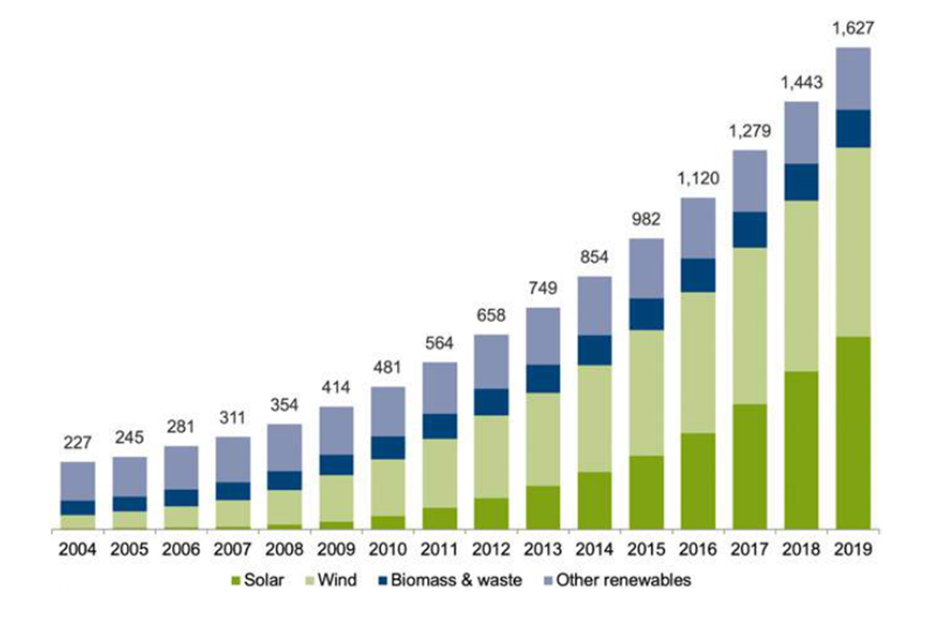
Global Renewable Transition
A global renewable electricity transition is ramping up on the strength of solar and wind component manufacturing scale economies and opportunities to replace aging thermal power plants.
Scale economies in battery and fuel cell manufacturing will ramp up a parallel and synergistic transition in the transportation sector that will enable local energy resilience as well as smoothing of daily electricity demand.
Renewable hydrogen will enable smoothing of seasonal and emergency demand as its production for use as a transportation fuel expands.
Global Capacity in Renewable Power, 2004-2019
Source: Bloomberg NEF

Slide 4
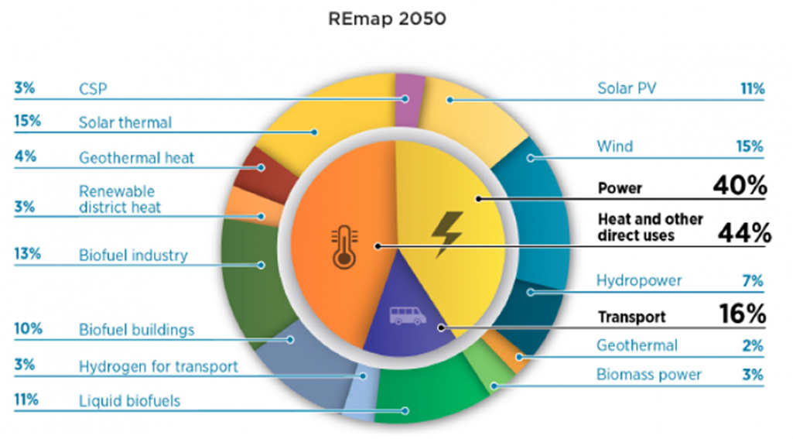
Electricity Is Only 40% of Global Energy
Replacing transport and heating fuels with electricity would require two and a half times the amount of current global electricity usage.
Bio-fuels, renewable hydrogen and renewable heat are essential complements to renewable electrification.

Slide 5
Solar Electrification Retrofits are Affordable in Northern California

Slide 6
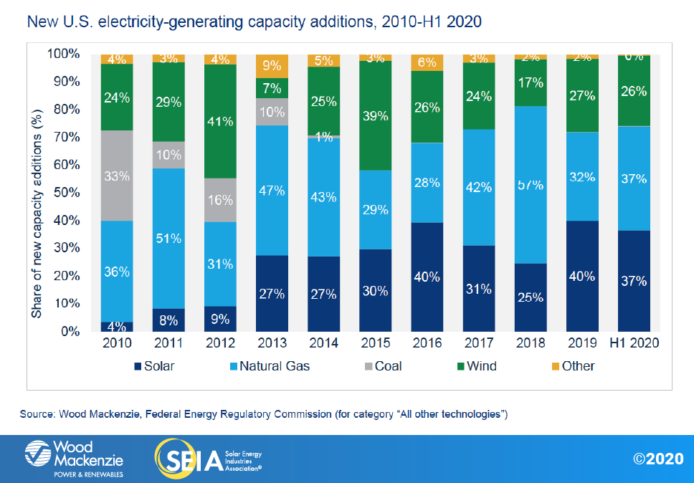
Solar Power in the US and California
Solar and wind power now account for more than 65% of power generation capacity additions in the US.
California has the largest solar market in the U.S. and has been a longtime champion of solar because of California’s excellent solar resource and the many economic and environmental benefits it provides, including billions in local investment.
Solar supplies more than 20 percent of California’s electricity today, but it must play a bigger role if the state is to reach climate and energy goals.

Slide 7
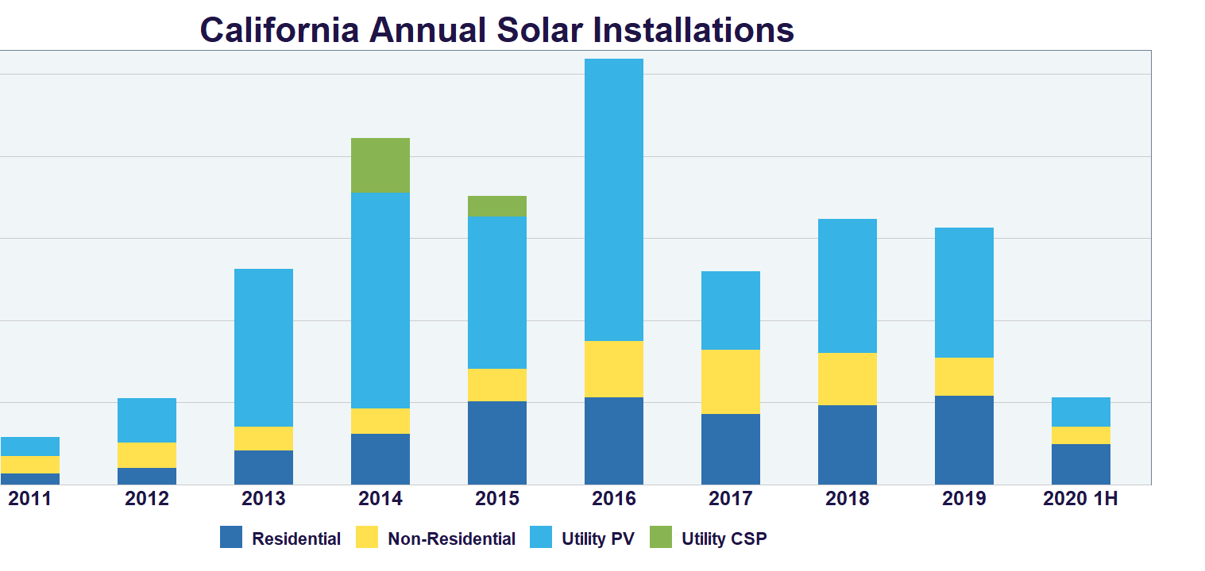

Slide 10
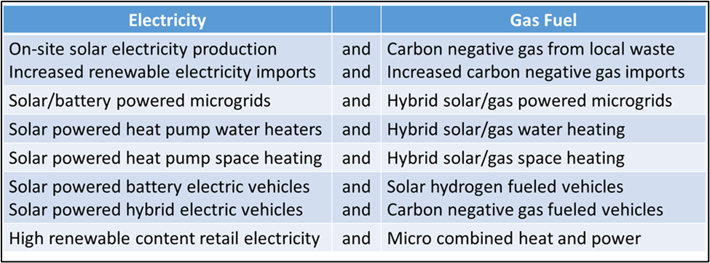
Local renewable decarbonization and resilience
Acceleration is possible if there is progress on parallel paths.
Source: G. Braun, Local Gaseous Fuel Decarbonization and Resilience for Southern California, 2020

Slide 11
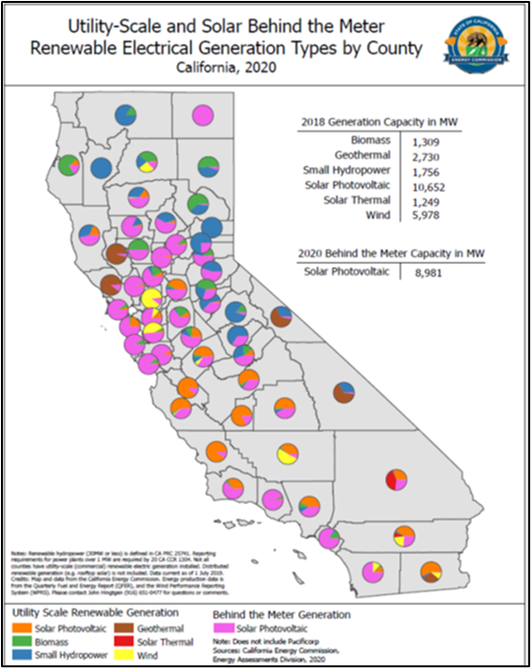
Renewable Energy Deployment Trade-offs
All new and replacement electricity supply capacity in the U.S. now relies on solar, wind and natural gas sources. About half of solar electricity deployment in California to date has been local. By contrast, the U.S. has a utility solar sector four times as large as its combined local (residential and non-residential) solar sectors.

Slide 12
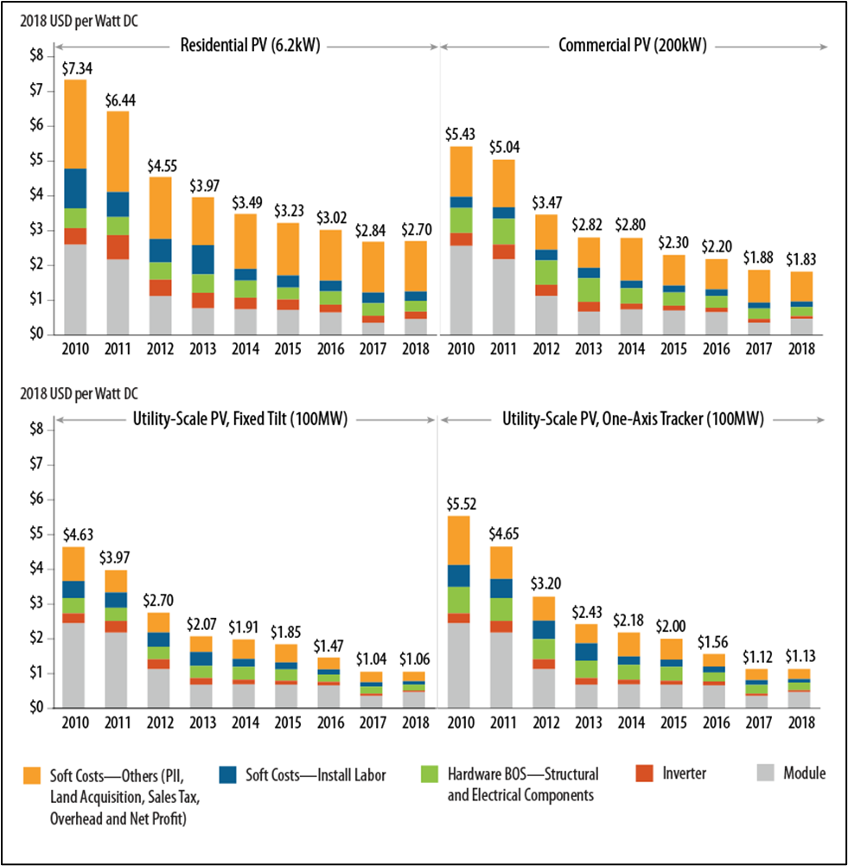
Trends in US Solar PV Systems Cost
Comparative economics of centralized vs. local renewable energy production will continue to shift in favor of local production as small projects proliferate, and as large projects come on stream and drive slow and costly expansion of high voltage transmission capacity and create a need for longer duration and more costly energy storage.

Slide 13
Other Trends in Northern California Energy
Reliability. Electricity service reliability has plummeted in recent years for communities and energy users subject to “public safety power shut-offs” during seasons when high winds increase wildfire risks.
Resilience. Energy resilience is the local capacity to restore energy service quickly and indefinitely. Increased local renewable energy production and judicious renewable fuel use can provide partial energy resilience, thus mitigating local energy service disruption. Full energy resilience requires fully resilient local sources.
Equity. Solar energy saves money and backs up traditional energy service for local businesses and homeowners and can do the same for renters, who, on average, may have greater need for cost savings and energy security.
Local Deployment Capacity. Deployment capacity matures as experience accumulates. California counties and cities with mature local solar deployment capacity are seeing sustained double digit annual on-site solar expansion.

Slide 14
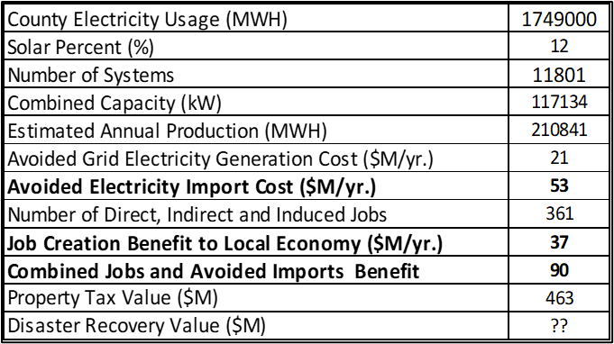
Valuing Local Renewable Energy Benefits*
Estimated $90 millions in benefits to the Yolo County economy include desirable jobs and less money leaving the county to pay for grid electricity imports. Additional economic benefits, harder to quantify on an annual basis, include mitigation of economic productivity losses during public safety power shutoffs, plus faster recovery of local economies in the wake of disasters, physical attacks and cyber-attacks.
On-site solar accounts for 12% of Yolo County electricity usage.
Solar improvements are exempt from property tax until property is sold, delaying and reducing tax base effects.
Incremental on-site solar capacity to charge electric vehicles typically results in greater capacity per site.
Disaster recovery value increases as storage capacity is added and as solar capacity is connected to microgrids.
Investments in space and water heating system retrofits to achieve site-level net zero carbon can have secondary job creation and disaster recovery benefits.
*Estimated On-site Solar PV Benefits to the Yolo County Economy at 2020 Year End
Notes:
These dollars strengthen the county’s ability to fund the implementation of climate adaptation and resilience measures, and they can help address inequities, including the fact that property owners have access to cost-saving locally produced solar electricity - renters do not.

Slide 15
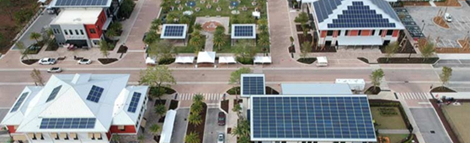
Local Electric Systems and Local Control
Future local electric systems will include sources and storage. Local grids will adapt. The alternative is “grid defection”.
California cities served by municipal utilities have more flexibility and control to plan and implement local renewable energy transitions and capture economic benefits for their communities. Will they?
Municipalization, which could empower local renewable energy transitions served by regional monopolies is still stymied at the city and county level in California. So, transformative change may have to proceed at the grid edge.
Collaboration is required when you do not have complete control.
Notes:
Future local electric systems will include sources and storage. Local grids will adapt. The alternative is “grid defection”.
California cities served by municipal utilities have more flexibility and control to plan and implement local renewable energy transitions and capture economic benefits for their communities.** Will they?
Municipalization, which could empower local renewable energy transitions served by regional monopolies is still stymied at the city and county level in California.* So, change may have to proceed at the grid edge.
Collaboration is required when you do not have complete control.
**Collaborative municipalization of grid assets prior to deployment in newly developed residential, commercial or industrial areas is a more focused and selective approach to local government engagement in providing energy services.
*New municipal utilities are not being formed in California, in part because Community Choice, which has the perceived benefit of local control, can be implemented with minimal local government financial exposure.

Slide 16
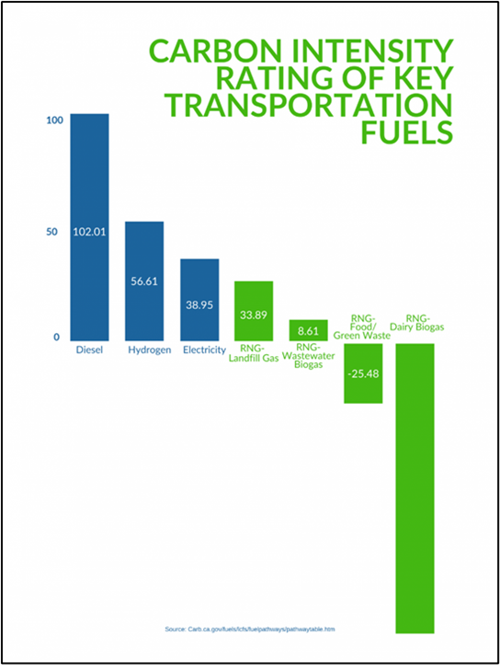
Local Energy Collaboration Targets
Net Negative Carbon Local Fuel Production. Bio-methane produced from organic waste streams has widely varying carbon intensities, some deeply negative and some modestly positive.
Net Positive Renewable Electricity. In California and most other US states, “net metered” solar electric arrays on new buildings can be sized to meet projected electricity usage. By contrast, arrays on existing buildings can only be sized to meet historical annual usage.
Local Energy Resilience. Neither utilities nor local governments, acting alone, can achieve the best economic and resilience outcomes for a community.
Synthesis of California Air Resource Board Low Carbon Fuel Standard 2020 Pathway Certified Carbon Intensities (Source: AmericanNaturalGas.com)
Notes:
Carbon intensities of major energy sources vary widely, both generically, and project-by-project. The figure shows carbon intensities for current and emerging transportation fuels. Bio-methane produced from organic waste streams has widely varying carbon intensities, some deeply negative and some modestly positive, depending on project design and operation. The figure shows that substituting bio-methane, aka renewable natural gas (RNG), for diesel fuel has the greatest potential decarbonization benefit in the transport sector. Other recent studies suggest that sufficient bio-methane production feedstocks are available to support significant substitution of bio-methane for natural gas (aka geologic methane) for building space and water heating.
To avoid mismatches between local electricity usage and local solar electricity supply, it now makes more sense to encourage on-site energy storage investments and allow predictable amounts of net annual solar electricity supply to feed into local grids during high usage periods and be credited at fair prices.
Local governments can determine the amounts of solar electricity feeding into local electricity grids that suffice to support economic activity during prolonged regional grid outages. Utilities can incentivize energy storage investments and net usage patterns consistent with efficient grid asset utilization. Coordinated local policies and plans should be finalized following independent review and public input.

Slide 17
Strategies - 1
Locally Specific Vision. A locally specific vision is a statement of the changes the jurisdiction has authority and aspires to make that empower economically beneficial local renewable energy investment.
Essential Local Government Roles. Cities and counties can play roles they already play in other areas. New roles are required that require energy management and engineering skill sets!
Renewable Energy Site Inventories. Sites suitable for renewable energy development should be inventoried and assessed to determine their economic value for purposes of renewable project development.
Notes:
In preparation for vision development and adoption, a county’s or city’s energy sources and usage must be profiled, along with forecasts accounting for trends that are changing the profile. Inputs to integrated local energy analysis need to be extracted from multiple databases and regularly updated. So, arrangements for data sharing with energy service providers are essential.
Cities and counties are taking roles in local renewable energy deployment that mirror their roles in other areas - enforcing codes, permitting projects, licensing local service providers and generally securing the public interest in safe, competent and environmentally appropriate services supportive of local renewable energy transitions. Cities and counties will also take on new roles, assessing renewable resource potential and zoning options, determining and prioritizing which local public facilities require energy resilience upgrades, identifying sites that are suitable for renewable project development, and enforcing local ordinances and regulations governing renewable energy transition services - for example, regulating community renewable energy production and community microgrid operations to ensure equitable cost recovery and service delivery.
Counties and cities manage land use within and around their boundaries. Some California jurisdictions now have experience that validates the critical need for anticipatory evaluations and decisions.

Slide 18
Strategies - 2
Decarbonization and Resilience Program Planning and Implementation. The same trade-offs confront each local jurisdiction, but choices will differ because local energy profiles and trends differ.
on-site solar vs. community renewables,
imports vs. local production,
new projects vs. retrofits,
zero carbon vs. fully energy resilient,
expedient vs. cost-efficient actions,
formerly affordable vs. newly affordable technologies, and
readiness for action now vs. later.
Growth and Maturation of Local Deployment and Retrofit Capacities. Lack of mature local deployment capacity is a main barrier to local renewable energy transitions and solar electrification retrofits.
Notes:
Local renewable energy transitions result in decarbonization, and they empower local energy resilience. To be timely and economically beneficial, they require political and technical attention and informed choices. When vision development and follow-up decarbonization and energy resilience planning is founded on locally specific energy system models and analysis, trade-offs are better informed, and achievable quantitative goals can be set. Plan implementation requires annual budgets and mature capacity to perform essential local government roles, assess progress, and identify and remove roadblocks.
Even in California, the retail solar industry’s capacity to deploy larger non-residential systems is less evenly distributed and less mature its residential solar deployment capacity; as a result, there are under-served cities and counties. Capturing local economic benefits of solar energy adoption requires a stable, profitable and growing local market for renewable energy systems. To this end, cities and counties can incentivize investments in local deployment capacity, invest in making critical facilities energy resilient, and approve ordinances requiring energy user consideration of solar electrification investments. They can learn by doing and lead by example by decarbonizing their own operations and facilities, by producing renewable fuels and renewable electricity for local use, and by committing to net zero carbon conversions of public schools and local government buildings and vehicles.

Slide 19
Implementation
Cities and counties are taking roles in local renewable energy deployment that mirror their roles in other areas - enforcing codes, permitting projects, licensing local service providers and generally securing the public interest in safe, competent and environmentally appropriate services supportive of local renewable energy transitions.
Cities and counties will also take on new roles, assessing renewable resource potential and zoning options, determining and prioritizing which local public facilities require energy resilience upgrades, identifying sites that are suitable for renewable project development, and enforcing local ordinances and regulations governing renewable energy transition services - for example, regulating community renewable energy production and community microgrid operations to ensure equitable cost recovery and service delivery.
Technical and analytical support for energy related roles can and likely will be outsourced, but implementation will require new staff competencies – primarily energy engineering and energy management

Slide 20
Recap
More than $2.7 trillion has been invested over the past decade in building up global renewable energy capacity. Renewable sources more than doubled their share of the global power mix, from 5.9% in 2009 to 13.4% last year.
Proportionate expansion of local renewable supply and storage is essential to timely, just, safe and economically beneficial local renewable energy transitions. It buys time as the climate clock approaches midnight. Local renewable energy transitions can out-pace state and national renewable expansion, while addressing local environmental and economic injustices and filling a growing energy resilience gap.
US cities and counties that accelerate local renewable transitions are acting in their self-interest. Planning and action in California to encourage investment in local solar energy production strengthens local economies in many, major ways while turbo-charging local decarbonization and energy resilience.

Slide 21
Thank You!
gbraun@iresn.org
www.iresn.org
Link to preprint: Local Renewable Energy Transition Strategies

